Slide 1




Digital portfolio
Name :
Register No :
NMID :
Department : College :
University :
Aasiya Farween J
2426J0806
asbru2426j0806
Information Technology
Maharani arts & science college, Dharapuram.
Bharathiar University, Coimbatore.

Slide 2
PROJECT TITLE
The Data Science Journey

Slide 3
Agenda
Project Overview
Problem Statement
Features & Functionality
End Users
Result & Screenshot
Tools & Technologies
Conclusion
Portfolio design & Layout
GitHub Link

Slide 4
PROJECT OVERVIEW
Developed a Data Science Portfolio showcasing:
Machine Learning models
Data Visualization dashboards
Predictive analytics use cases

Slide 5

Problem
Statement
Industries face challenges with:
Managing large datasets
Extracting meaningful insights
Making data-driven decisions
Need for skilled data scientists who can:
Clean, analyze, and visualize data
Build predictive and prescriptive models

Slide 6
WHO ARE THE END USERS?
Recruiters / Hiring Managers
👔
Peers & Learners
📚
Companies
🏢
Personal Branding
🌐

Slide 7
TOOLS AND TECHNIQUES
Libraries: Pandas, NumPy,
Scikit-learn, TensorFlow
Version Control: Git, GitHub
Languages: Python, R, SQL
Deployment: Flask, Streamlit
Visualization Tools: Power BI,
Tableau

Slide 8
Homepage:
Introduction + About Me
Projects Section:
Case studies, datasets, results
Skills Section:
Technical expertise
Contact Section:
LinkedIn, Email, GitHub
Design:
Clean, responsive, easy to navigate
PORTFOLIO DESIGN & LAYOUT

Slide 9
Interactive Dashboard
End-to-end ML Projects
Well-documented repositories
Visual Storytelling with graphs
Deployed Projects online
Features
and
Functionality
Features
and
Functionality

Slide 10
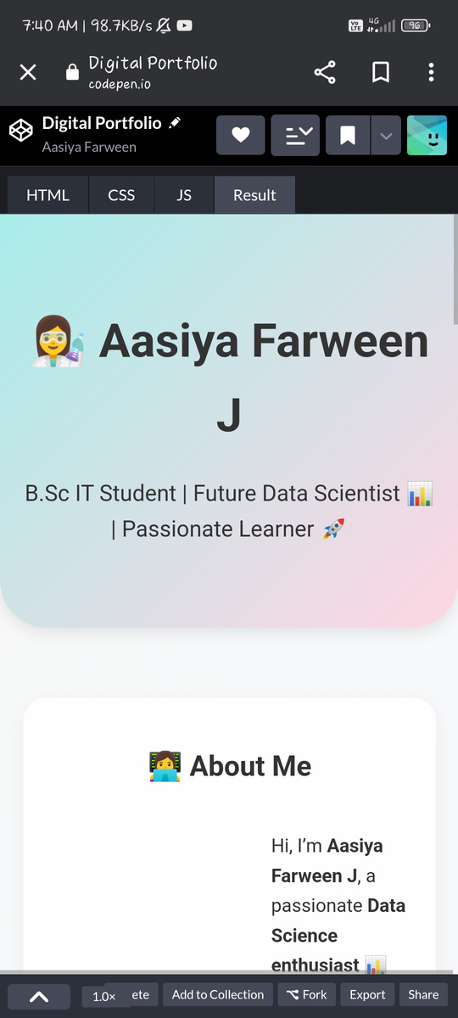
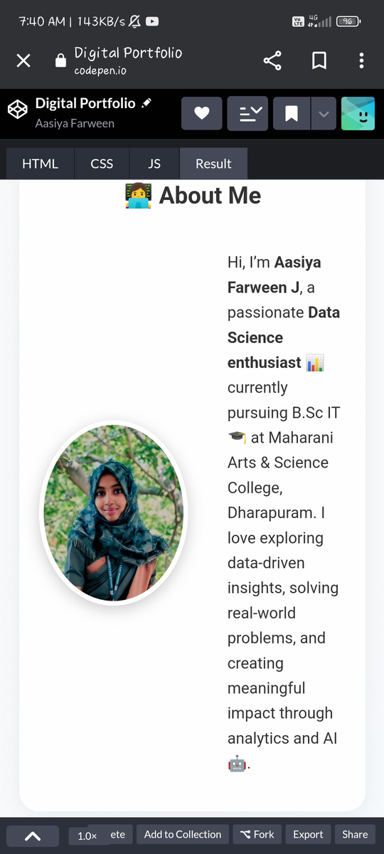
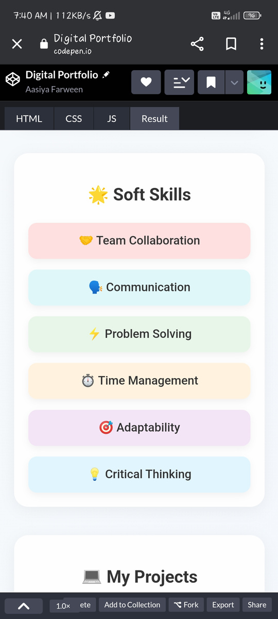
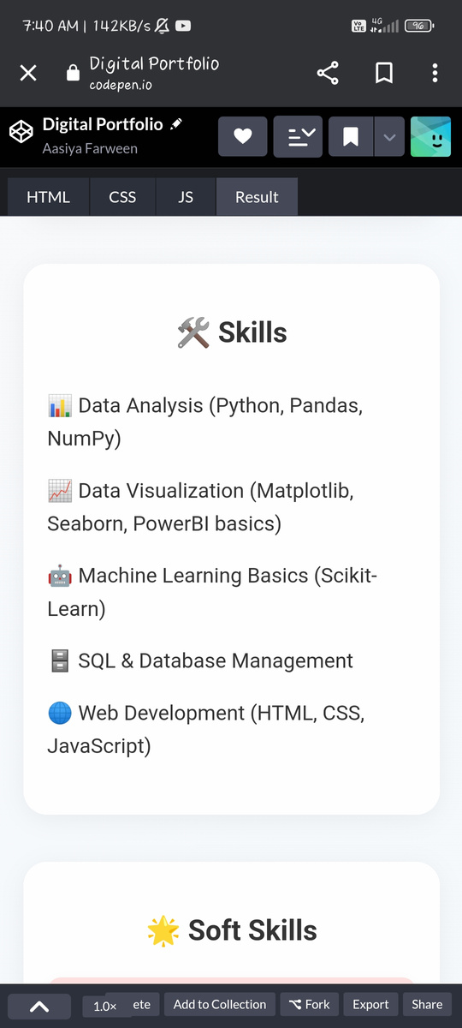
RESULT AND SCREENSHOT

Slide 11
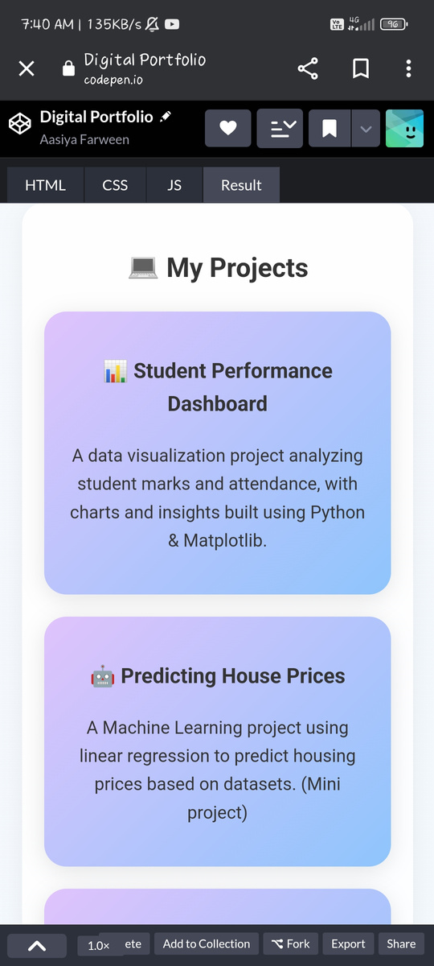
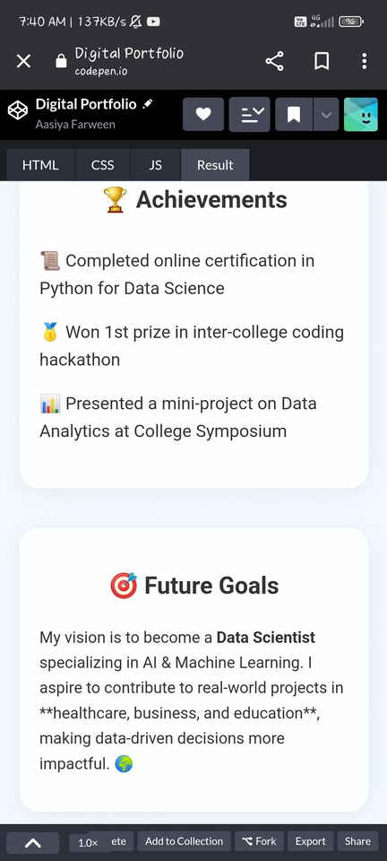
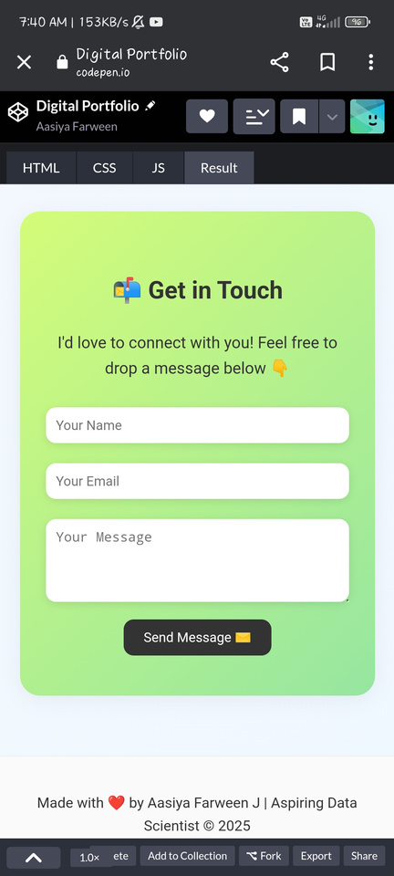
RESULT AND SCREENSHOT

Slide 12
CONCLUSION
Built a comprehensive Data Science Portfolio
Showcases skills in Data cleaning, analysis, visualization, ML
Strong Tool for career opportunities
Future scope: Deep learning, NLP, Big Data

Slide 13
GITHUB LINK 🔗 :

